Slide 1

ELECTRICITY BILLING SYSTEM
AN AOOP PROJECT

Slide 2
TEAM MEMBERS
A.VINAY KUMAR 2110030350
R.NAGAMANEESHWAR 2110030344
T.SANDEEP 2110030196
G.SAICHARAN 2110030437

Slide 3
INTRODUCTION
The project is a web based application where users can get instant electricity bill and pay them online via credit card. The system automates the conventional process of paying electricity bill by visiting the place. The system would be having two logins admin and user login.
Admin can view user account details and can even add or updates things in their account. Admin has to feed the system with electricity usage data into respective users account. The system then calculates the electricity bill for every user and updates the information into their account every month.
User can then view their electricity bill and pay on the spot before month end. If user is incapable of paying the bill before month end, it then calculates fine for each subsequent day.

Slide 4
Objective and purpose of the project
The primary objective of the Electricity Billing System is to keep track of invoices, customers, units, connections, and consumption. It keeps track of all bills, readings, purchases, and payments.
Electricity bills are the most significant communication tool between customers and power providers. Customers should receive fundamental information, as such as energy usage and unit cost, on their bills to help them understand their power use and spending, as well as their change in electricity consumption.

Slide 5
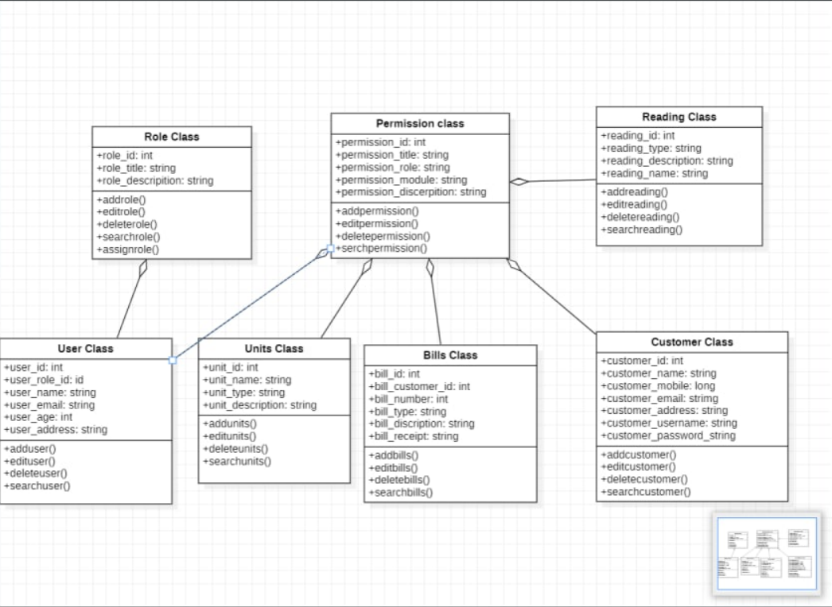
Class diagram

Slide 6
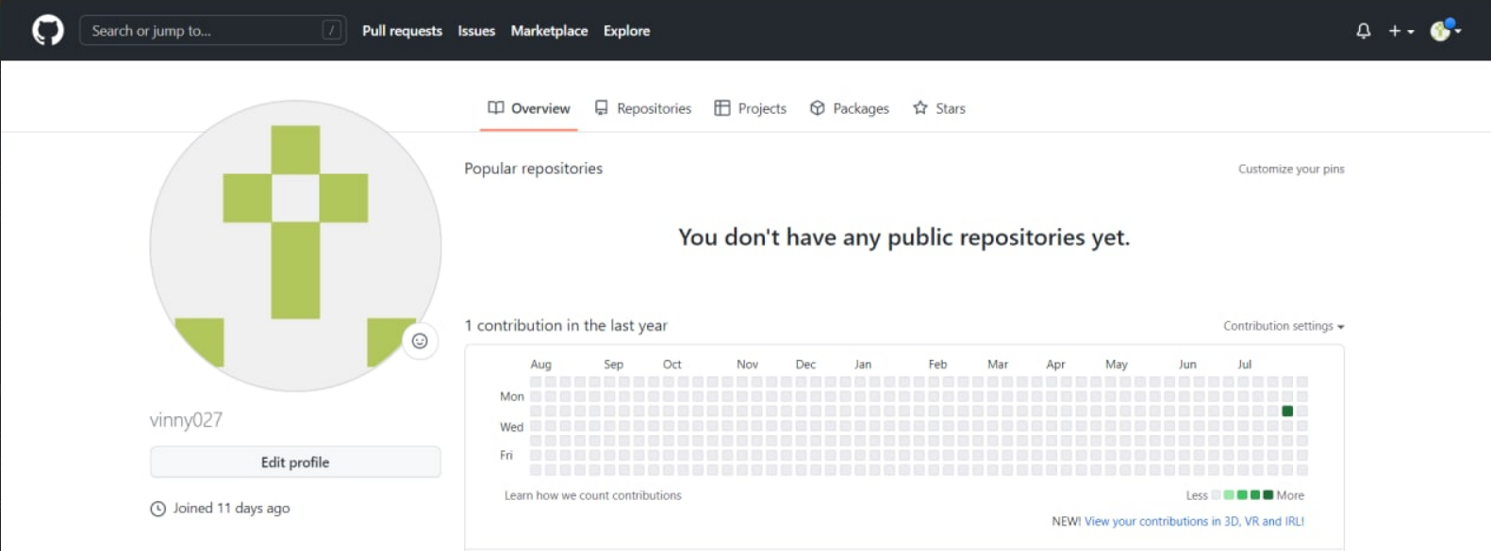
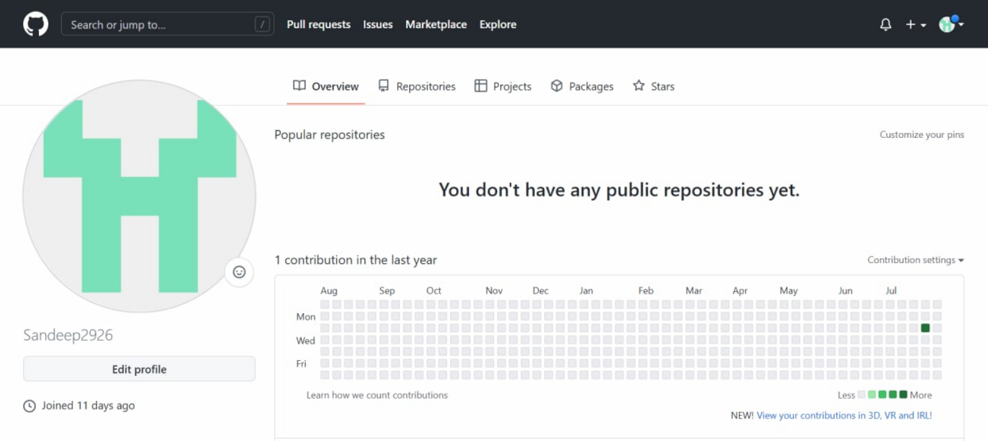
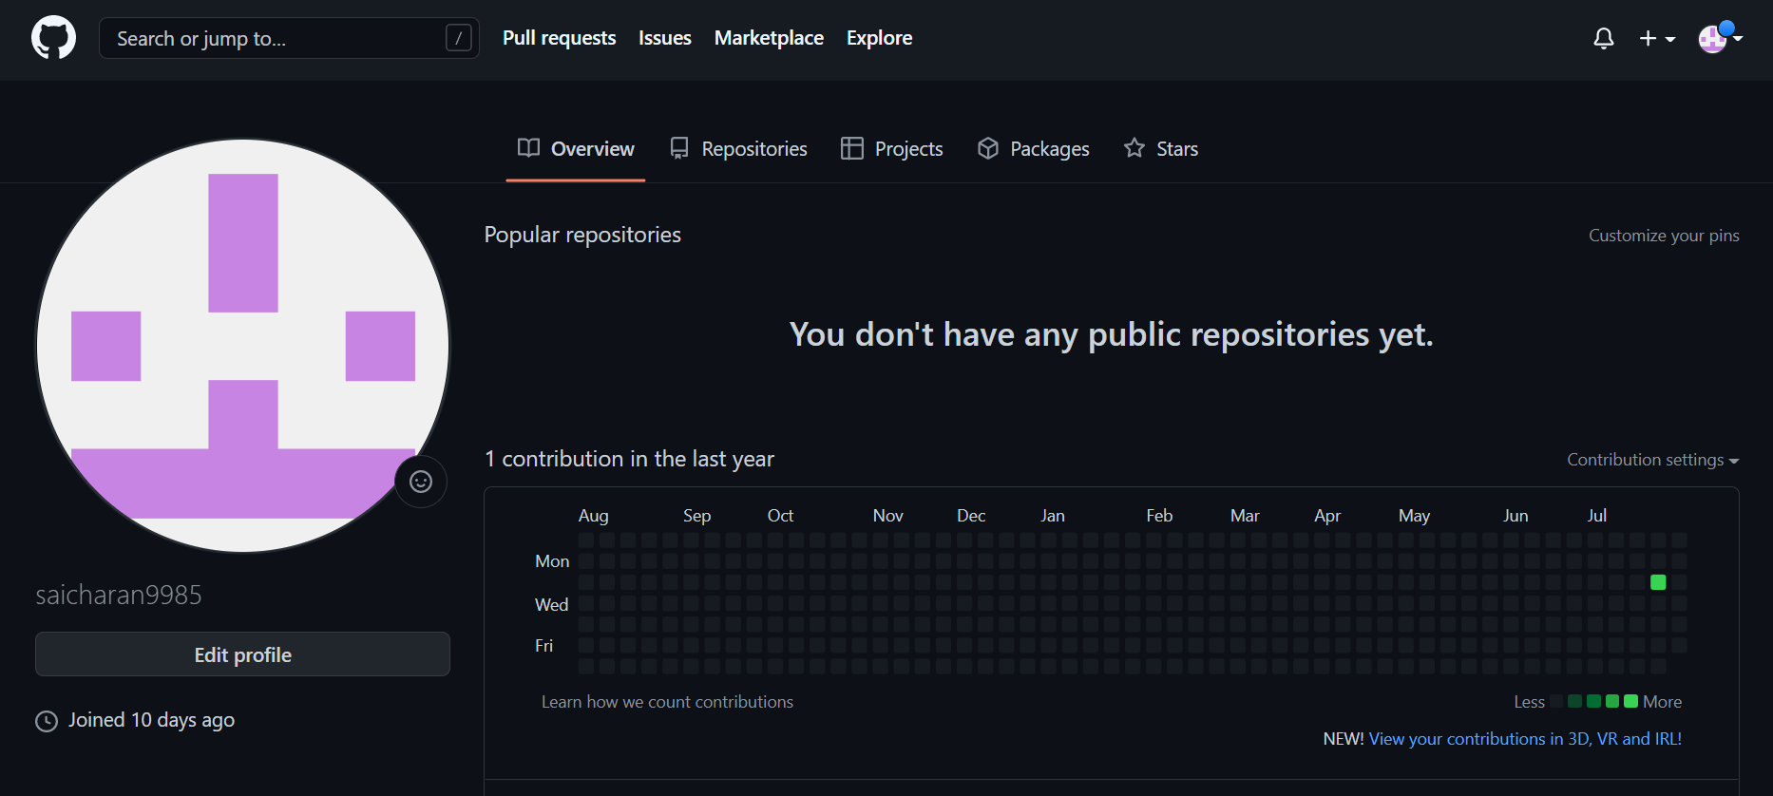
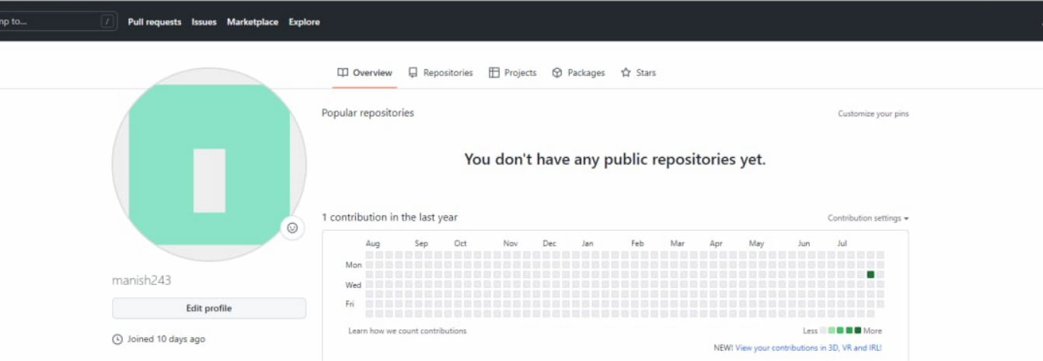
GITHUB SETUP

Slide 7
Conclusion
After all the hard work is done for the electricity bill management system is here. It is software that helps the user to work with the billing cycles, paying bills, managing different departments under which employees are working, etc. This software reduces the amount of manual data entry and gives greater efficiency.
The User Interface of it is very friendly and can be easily used by anyone. It also decreases the amount of time taken to write details and other modules.

